Slide 1
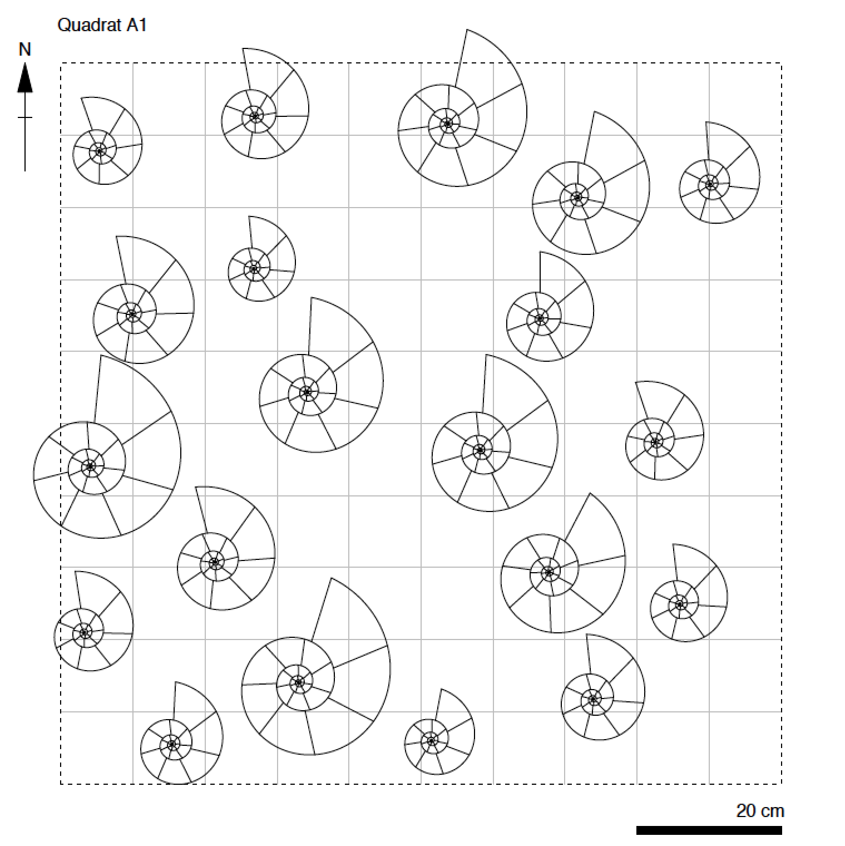
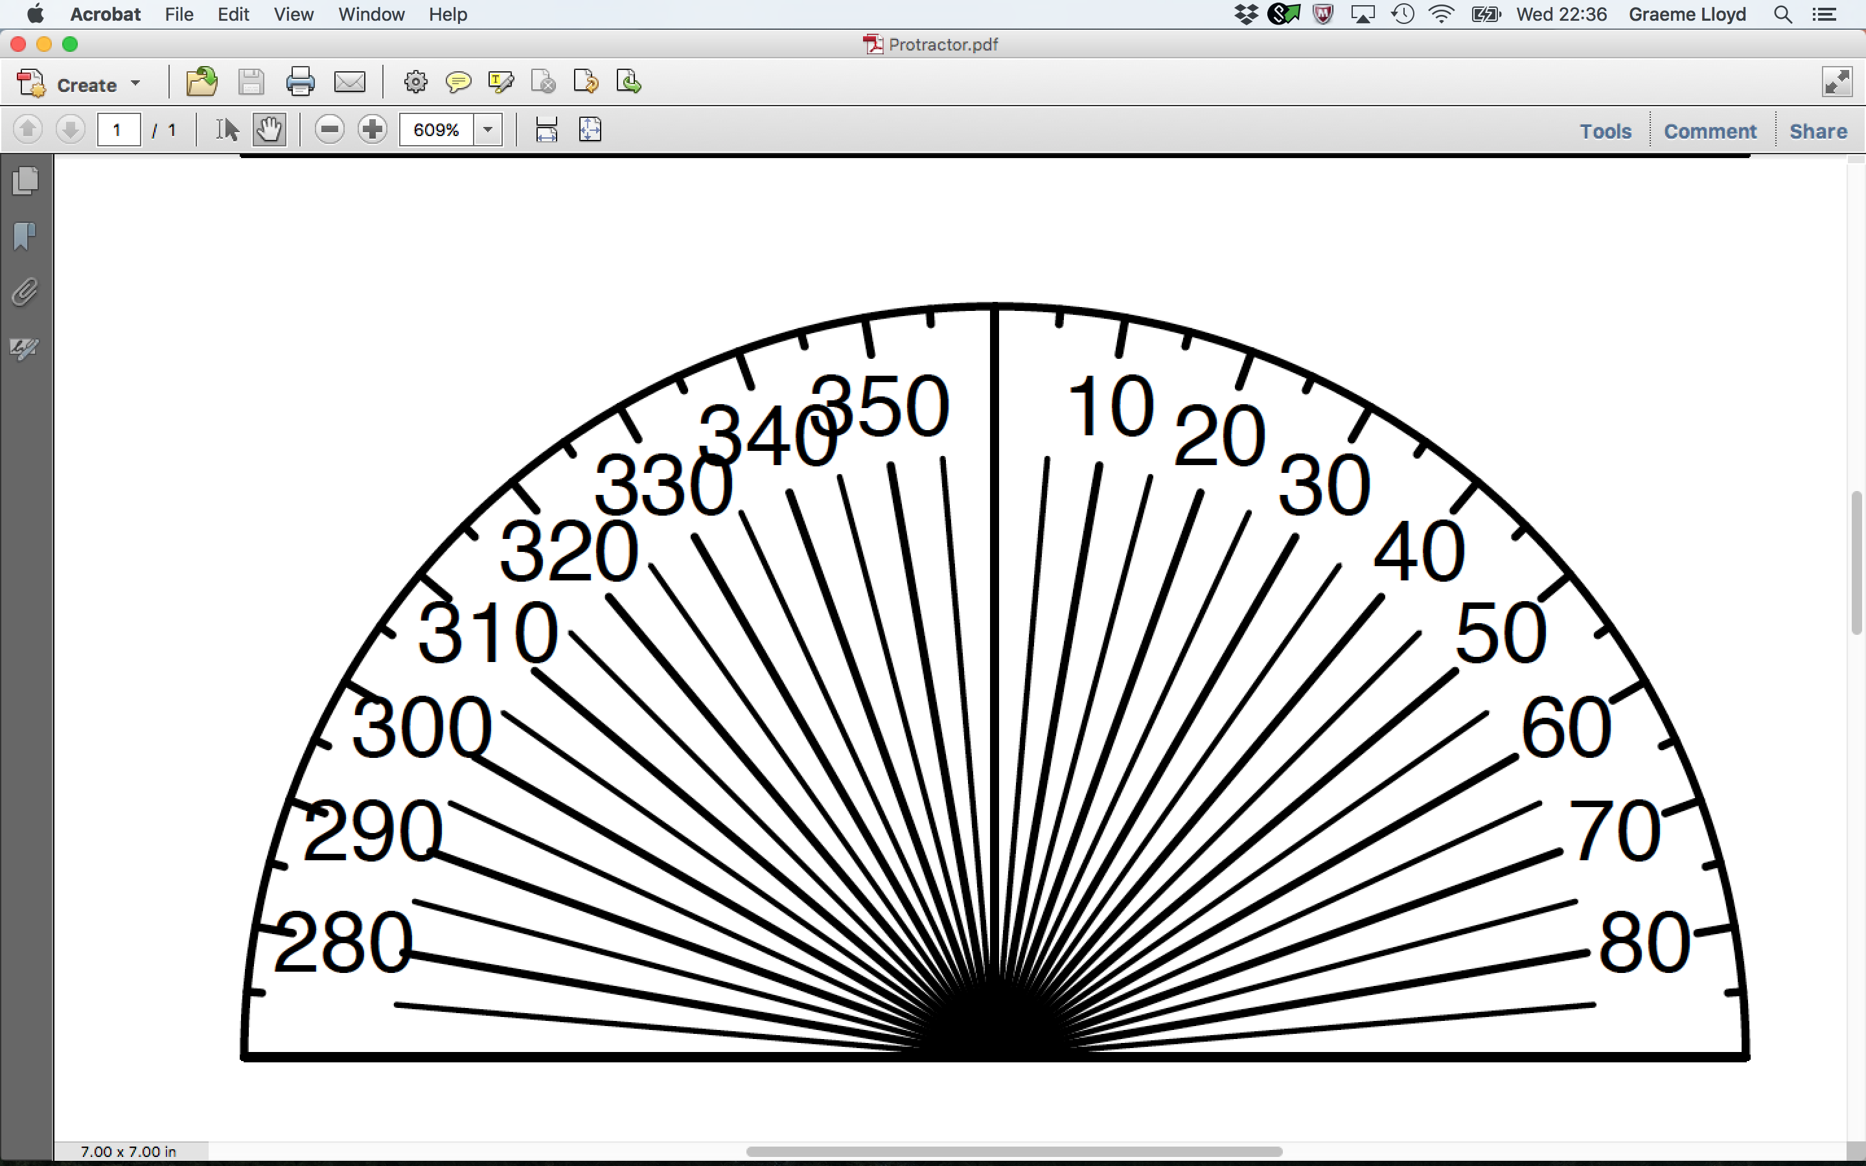
For today’s lecture you will need:
Your quadrat (spares at front)
Custom protractor
(at front)

Slide 2

SOEE1475 Statistics and Data Analysis
Lecture 7: Directional statistics
Graeme T. Lloyd

Slide 3

Today
Complexities of circular data
Resultant
von Mises distribution

Slide 4
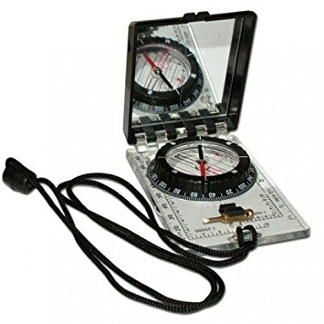
Circular measurements

Slide 5
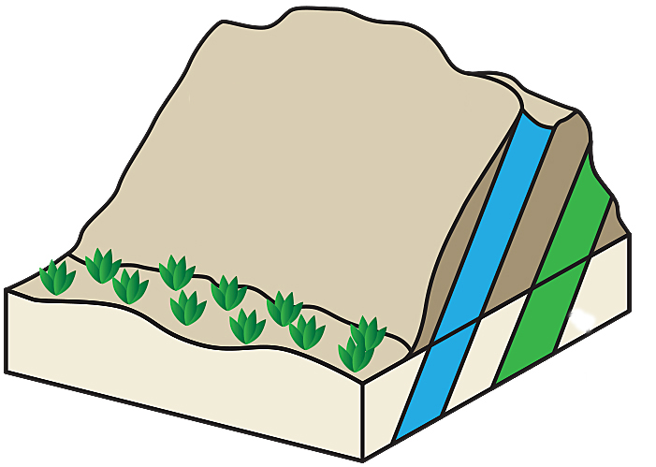
Circular measurements
Strike
Dip

Slide 6
Circular measurements
Strike
Azimuth
Dip
Plunge

Slide 7
Circular measurements
Dip/plunge
Closed, 0-90
0
90

Slide 8
Circular measurements
Dip/plunge
Strike
Closed, 0-90
Modulo, 0-180
0
0
90
180

Slide 9
Circular measurements
Dip/plunge
Strike
Azimuth
Closed, 0-90
Modulo, 0-180
Modulo, 0-360
0
360/0
0
90
180

Slide 10
Directional measurements

Slide 11
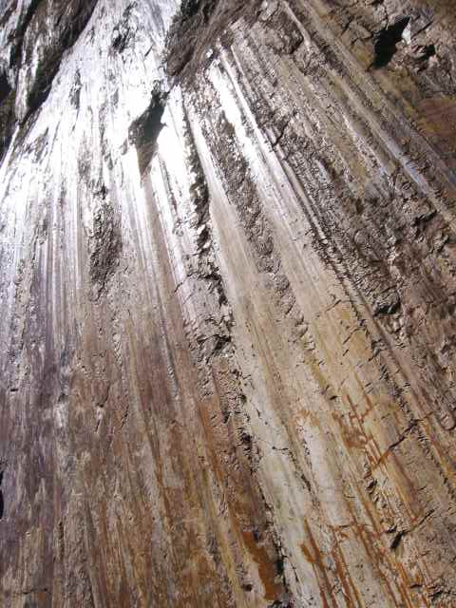
Directional measurements
Slickensides

Slide 12
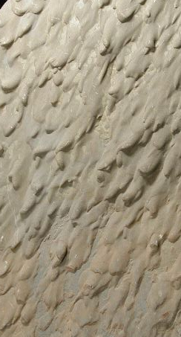
Directional measurements
Slickensides
Flute casts

Slide 13
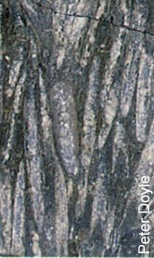
Directional measurements
Slickensides
Flute casts
Oriented fossils

Slide 14
Orientation measurements

Slide 15
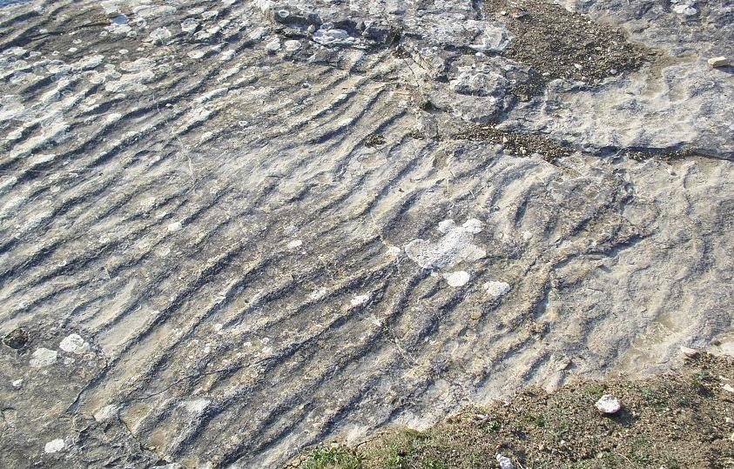
Orientation measurements
Ripple crests

Slide 16
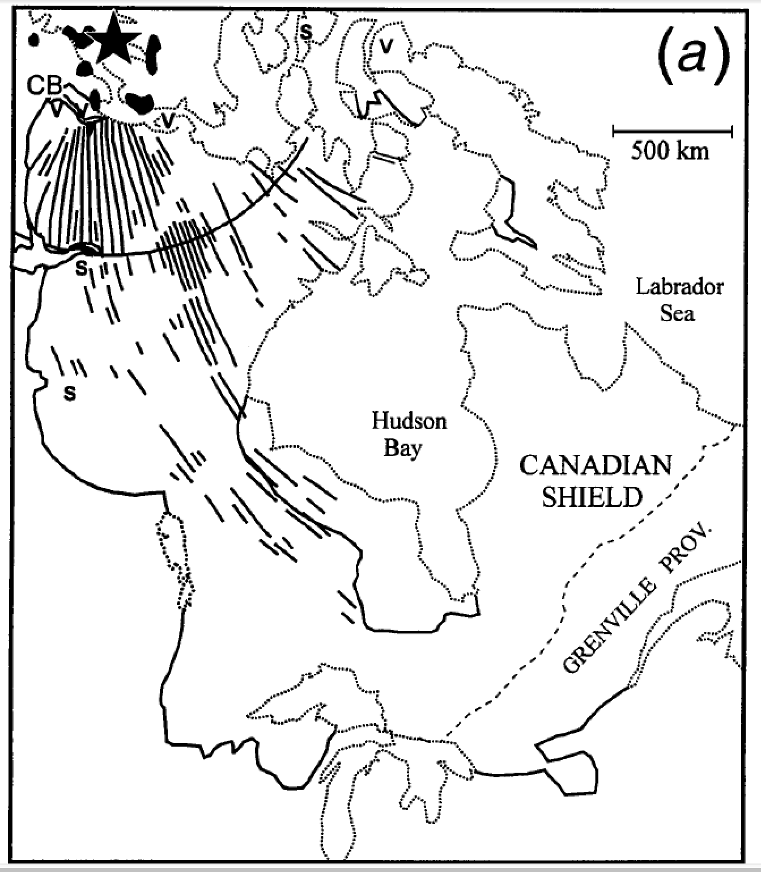
Orientation measurements
Ripple crests
Dike swarms

Slide 17
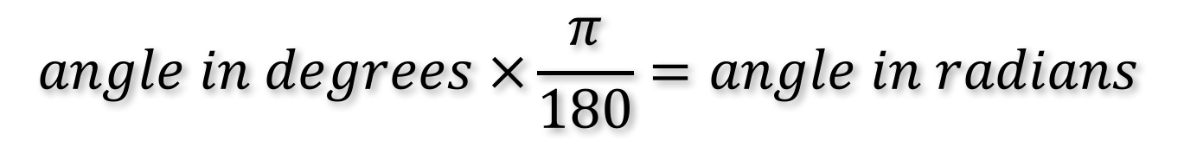
Degrees and radians
$$angle in degrees ×\frac{π}{180}=angle in radians$$

Slide 18
Degrees and radians
$$angle in degrees ×\frac{π}{180}=angle in radians$$
57.2958 degrees
1 radian

Slide 19

R
library(circular)

Slide 20
Visualisations

Slide 21
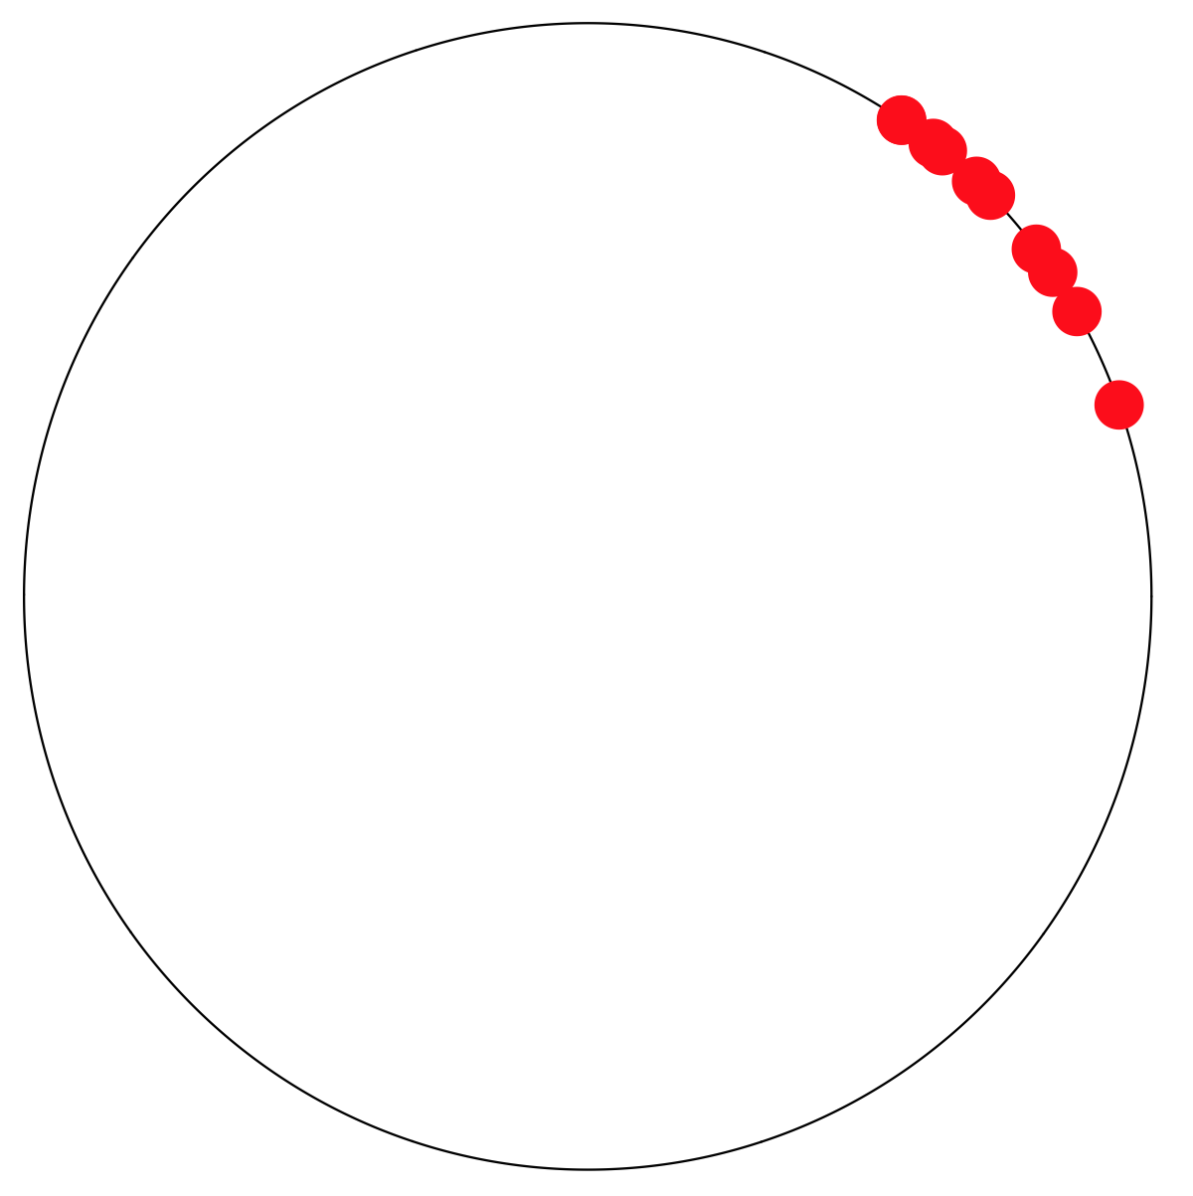
Visualisations
Circle plot

Slide 22
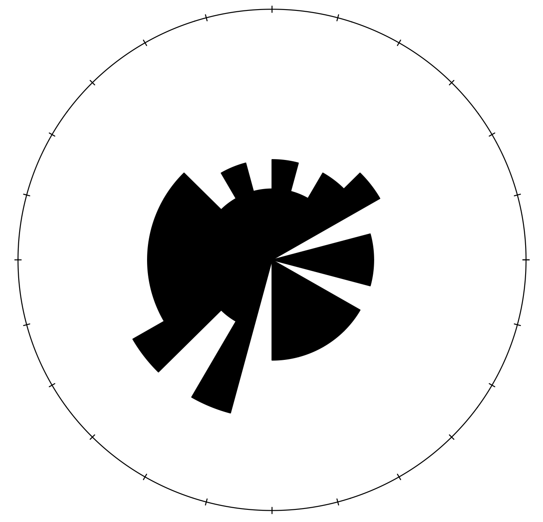
Visualisations
Circle plot
Rose diagram

Slide 23
Resultant

Slide 24
Resultant
Unit vectors

Slide 25
Resultant
Unit vectors
Arrange as path

Slide 26
Resultant
Unit vectors
Arrange as path
Resultant

Slide 27
Resultant
Unit vectors
Arrange as path
Resultant
Short
Long

Slide 28
Resultant
Resultant
Short
Long

Slide 29
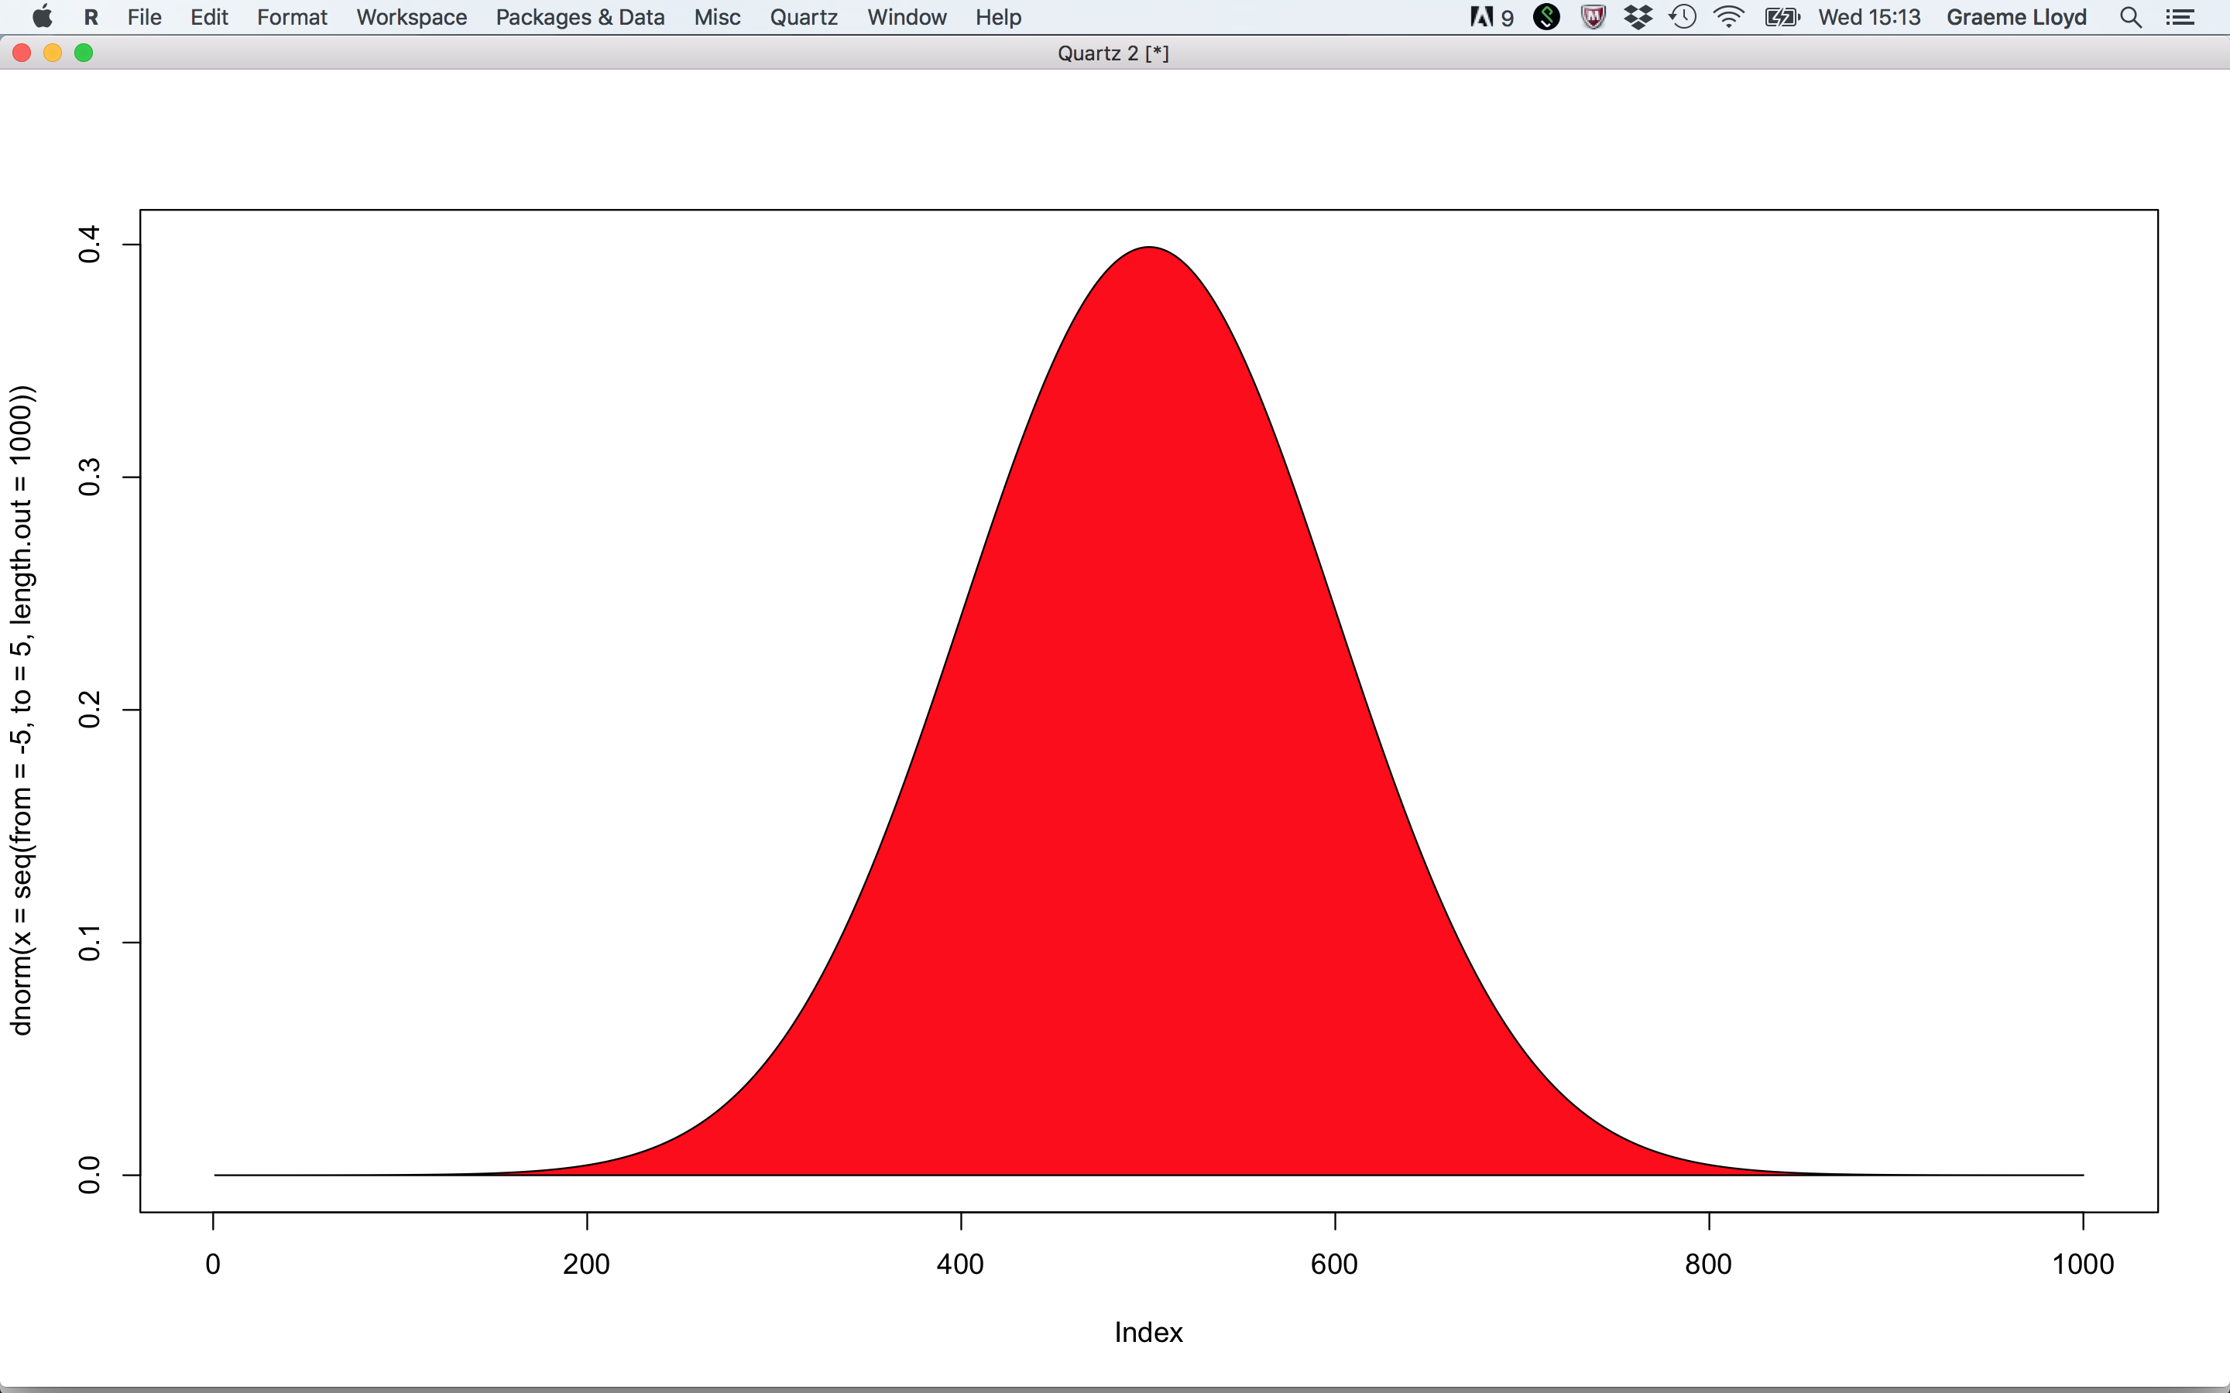
Resultant
Resultant
Dispersion
Short
Long

Slide 30
Resultant
Resultant
Dispersion
Mean
Short
Long

Slide 31
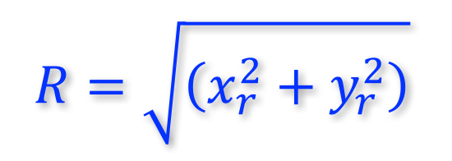
Resultant
Resultant length
$$R=\sqrt{\left(x_{r}^{2}+y_{r}^{2}\right)}$$
Inverse of dispersion; scales with n

Slide 32
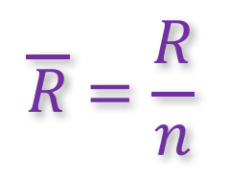
Resultant
Resultant length
$$R=\sqrt{\left(x_{r}^{2}+y_{r}^{2}\right)}$$
Inverse of dispersion; scales with n
Mean resultant length
$$\overline{R}=\frac{R}{n}$$
Rescaled, allowing comparison across samples; 0-1 range

Slide 33
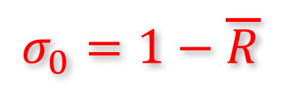
Resultant
Resultant length
$$R=\sqrt{\left(x_{r}^{2}+y_{r}^{2}\right)}$$
Inverse of dispersion; scales with n
Mean resultant length
$$\overline{R}=\frac{R}{n}$$
Rescaled, allowing comparison across samples; 0-1 range
Circular variance
$$σ_{0}=1−\overline{R}$$
Varies from 0 (low) to 1 (high)

Slide 34
Exercise

Slide 35
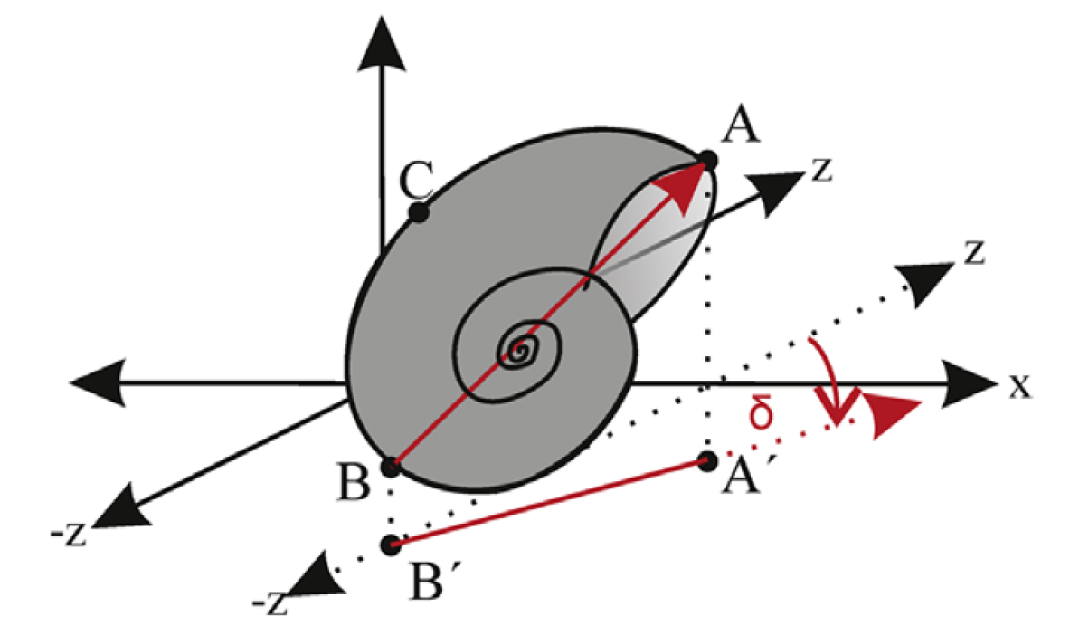
Exercise
Lukeneder et al 2014 Computers & Geosciences

Slide 36
Exercise
Lukeneder et al 2014 Computers & Geosciences

Slide 37
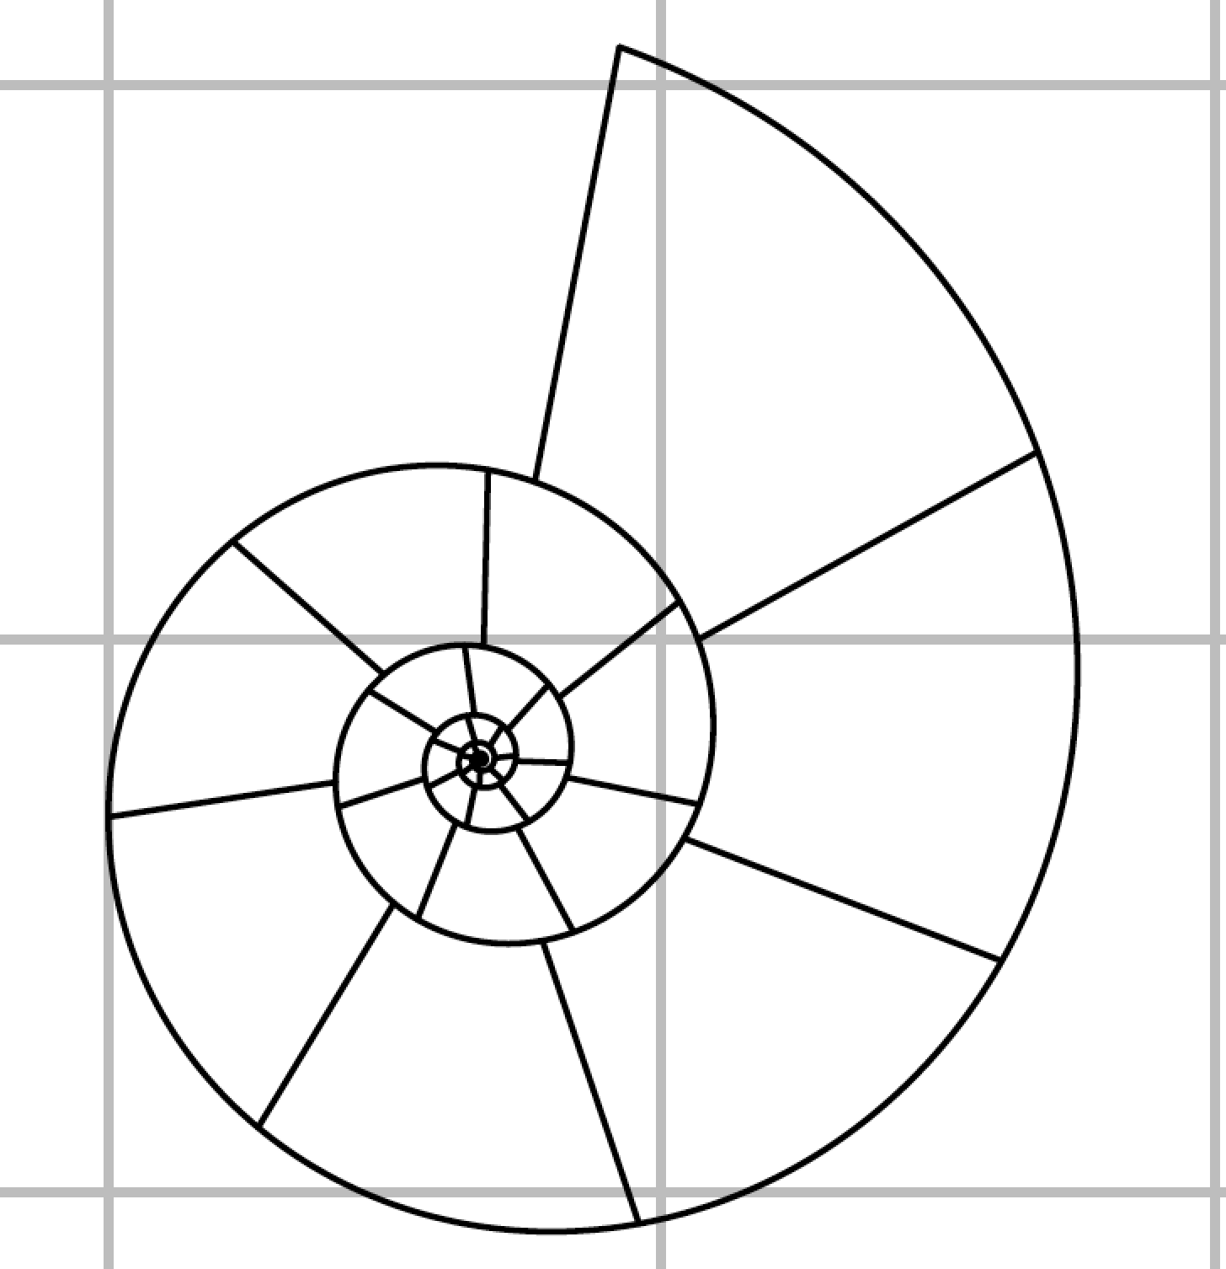
Exercise

Slide 38
Exercise

Slide 39
Exercise

Slide 40
Exercise
Measure ammonites 1 and 2 only
Units of protractor are bearings in degrees
Bin your data (for a histogram)
A
B
C
D
E
F
G
H
I
J
310
320
330
340
350
360
10
20
30
40
50

Slide 41
Exercise
Measure ammonites 1 and 2 only
Units of protractor are bearings in degrees
Bin your data (for a histogram)
A
B
C
D
E
F
G
H
I
J
310
320
330
340
350
360
10
20
30
40
50
J10: 1 = 29, 2 = 354

Slide 42
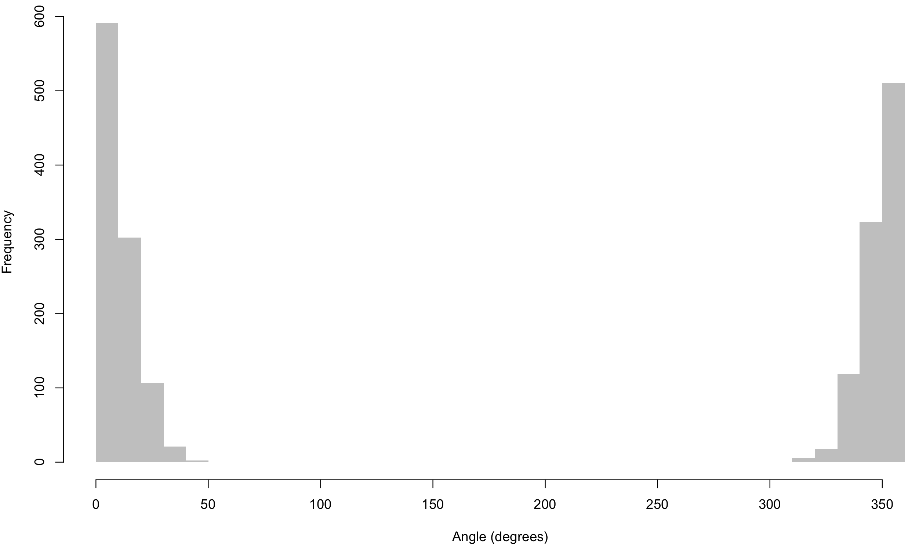
Exercise

Slide 43
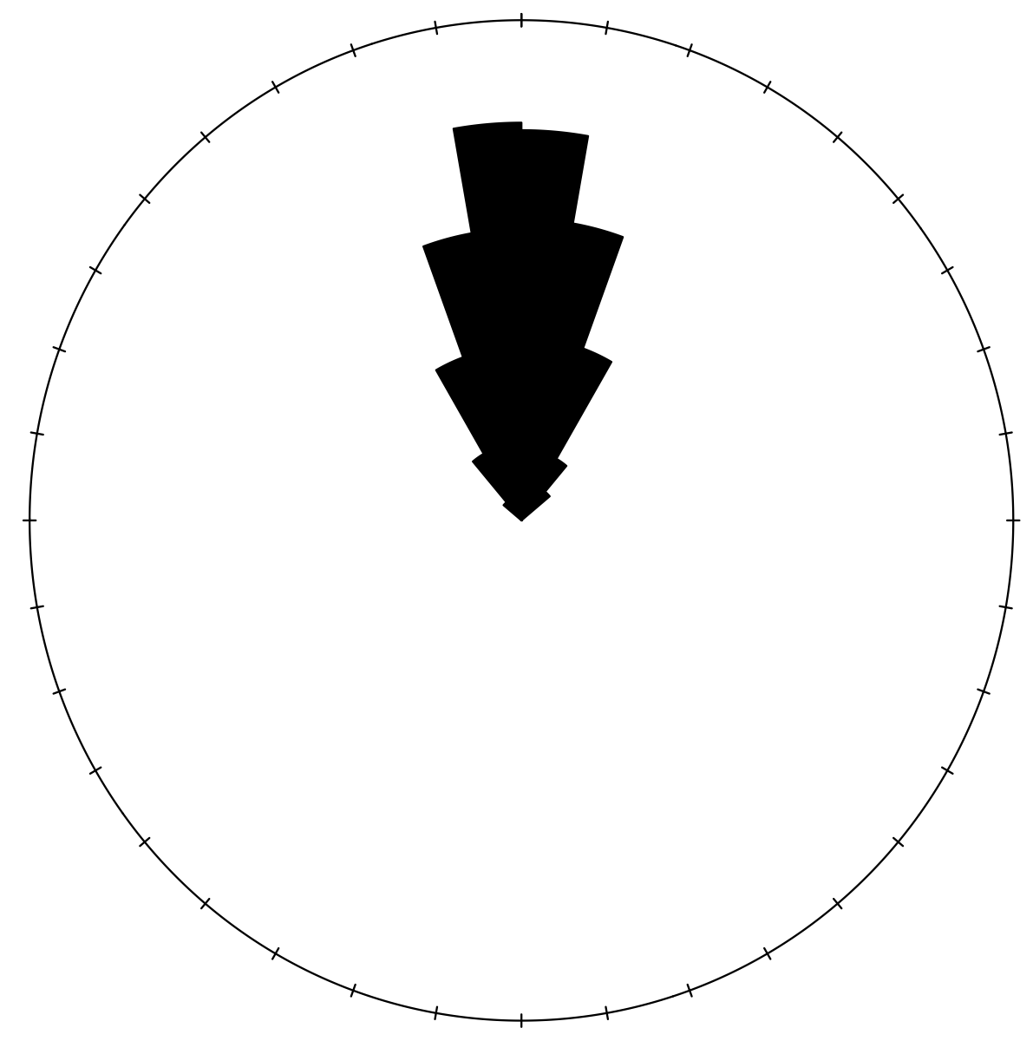
Exercise

Slide 44
Exercise
Measure ammonites 3-5
Calculate mean for all five bearings

Slide 45
Exercise
Measure ammonites 3-5
Calculate mean for all five bearings
J10: 1 = 29
2 = 354
3 = 346
4 = 4
5 = 9

Slide 46
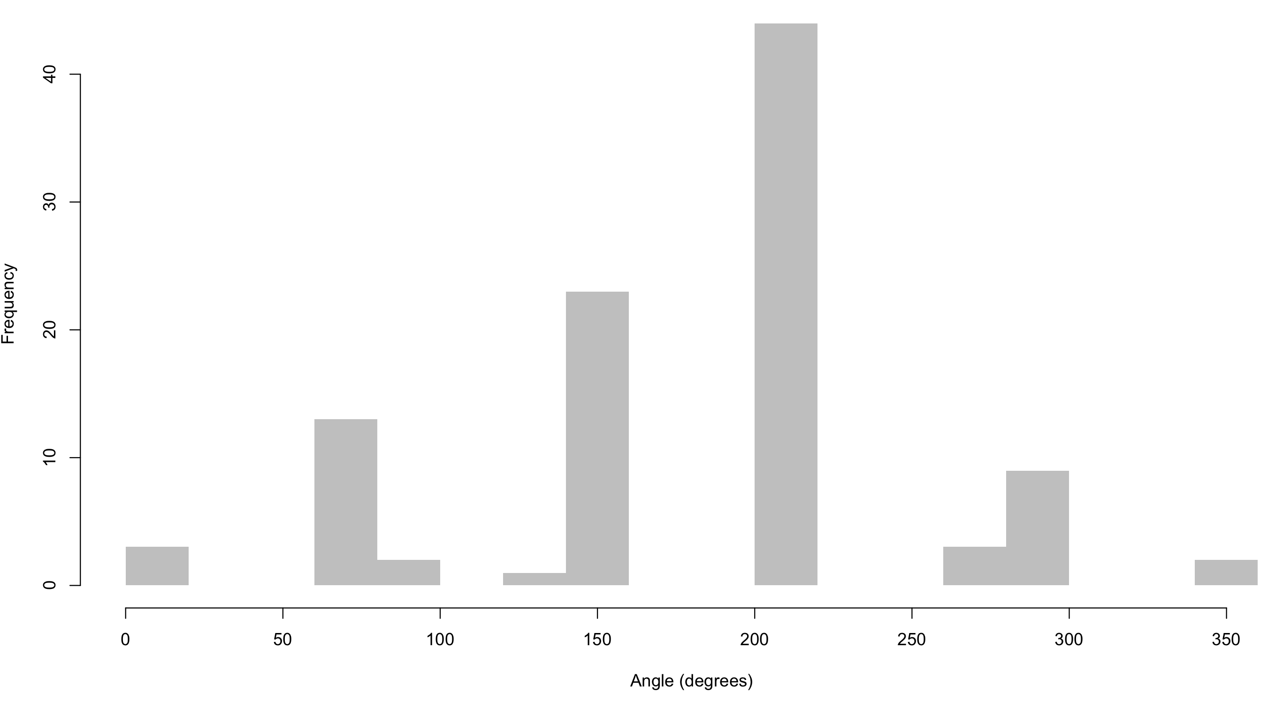
Mean bearing of first five ammonites

Slide 47
von Mises distribution
-∞
+∞

Slide 48
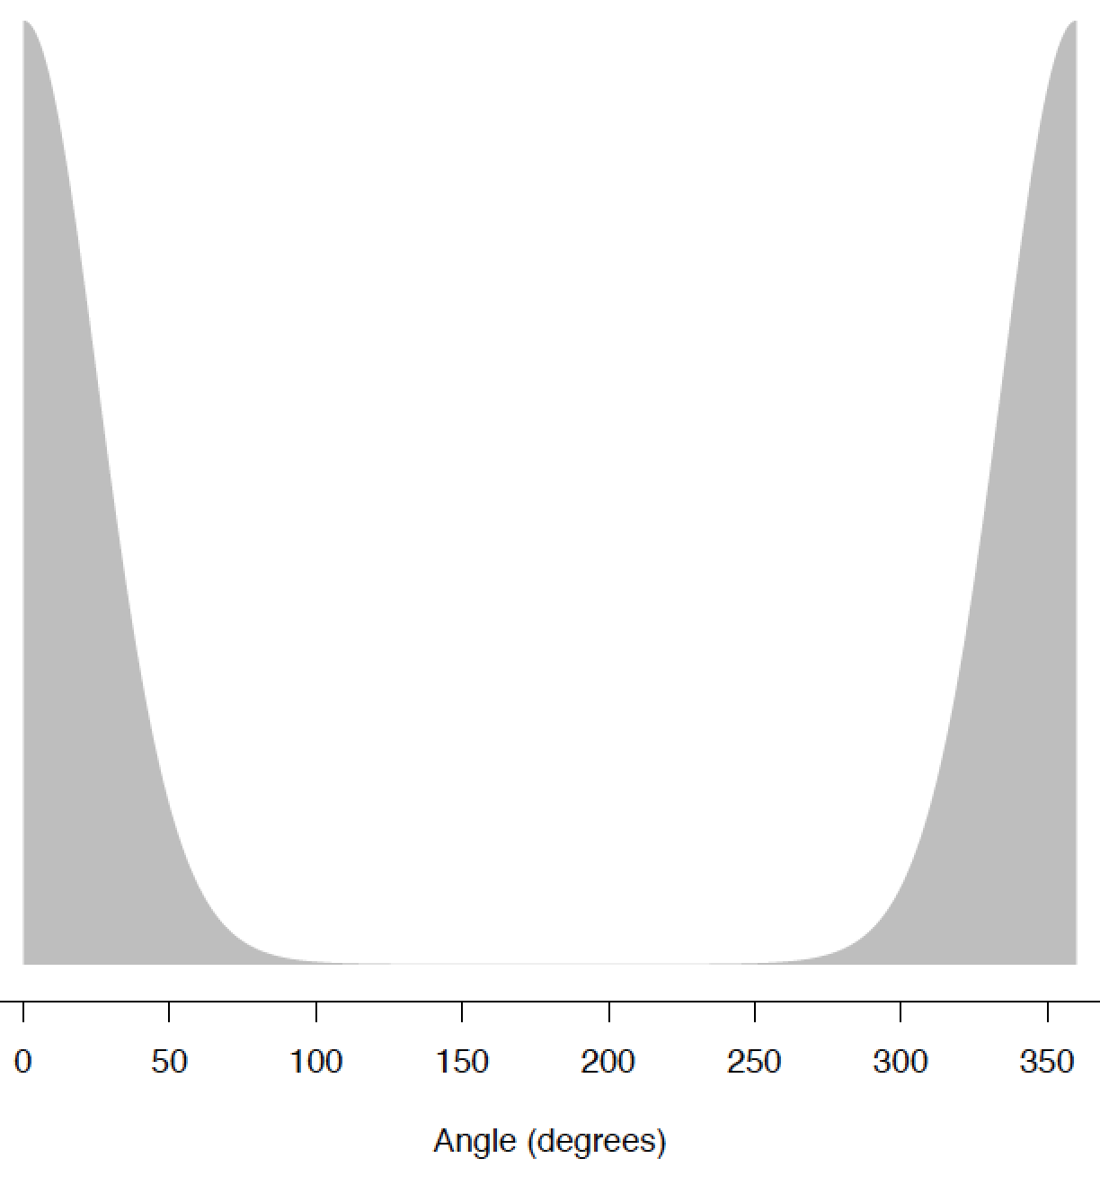
von Mises distribution
μ = 0
0
360

Slide 49
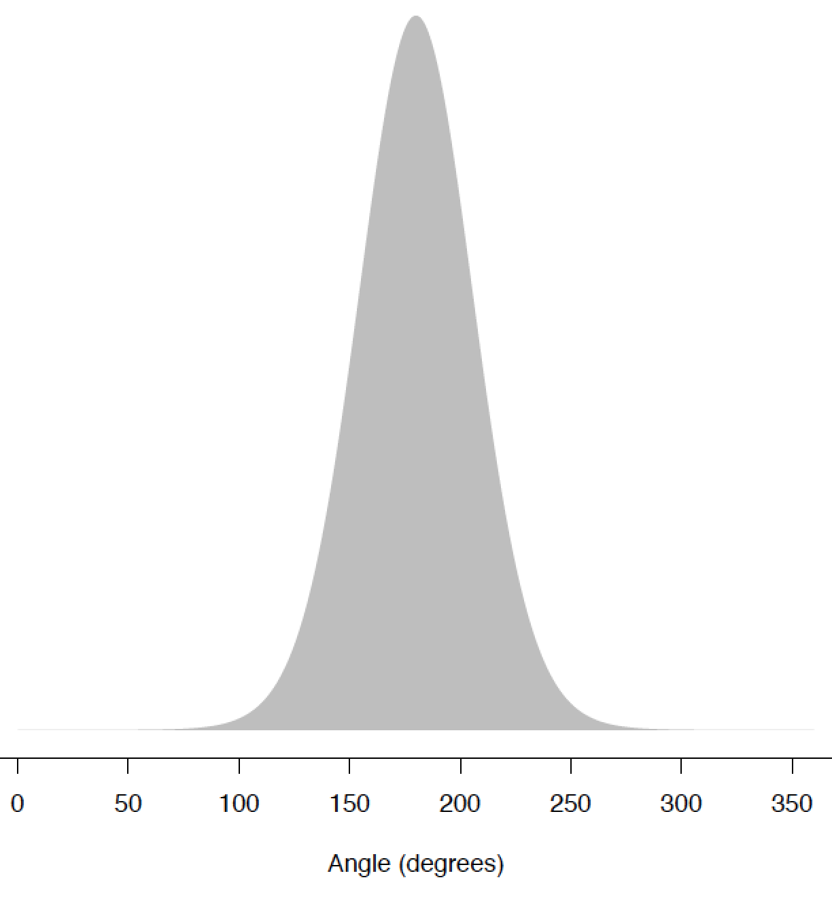
von Mises distribution
μ = 0
μ = 180
0
360
0
360

Slide 50
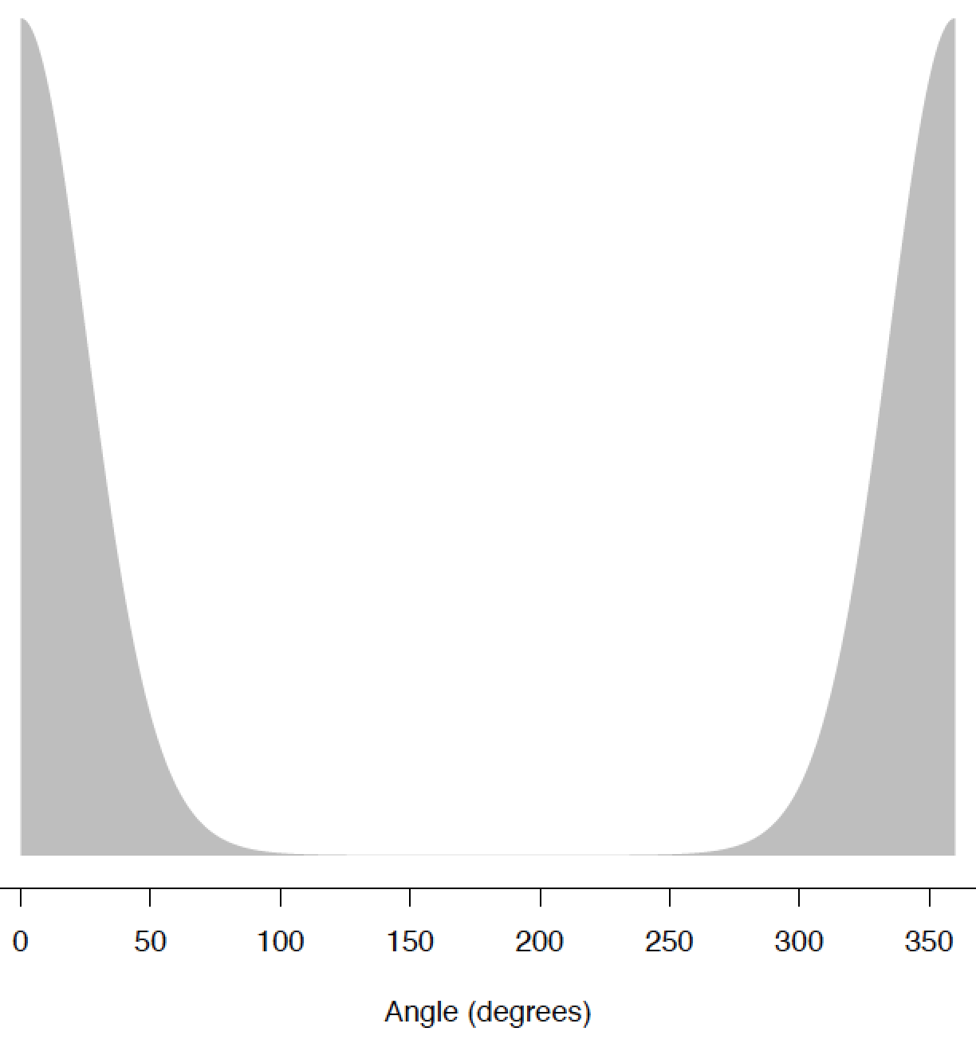
von Mises distribution
μ = 0
μ = 180
μ = 360
0
360
0
360
0
360

Slide 51
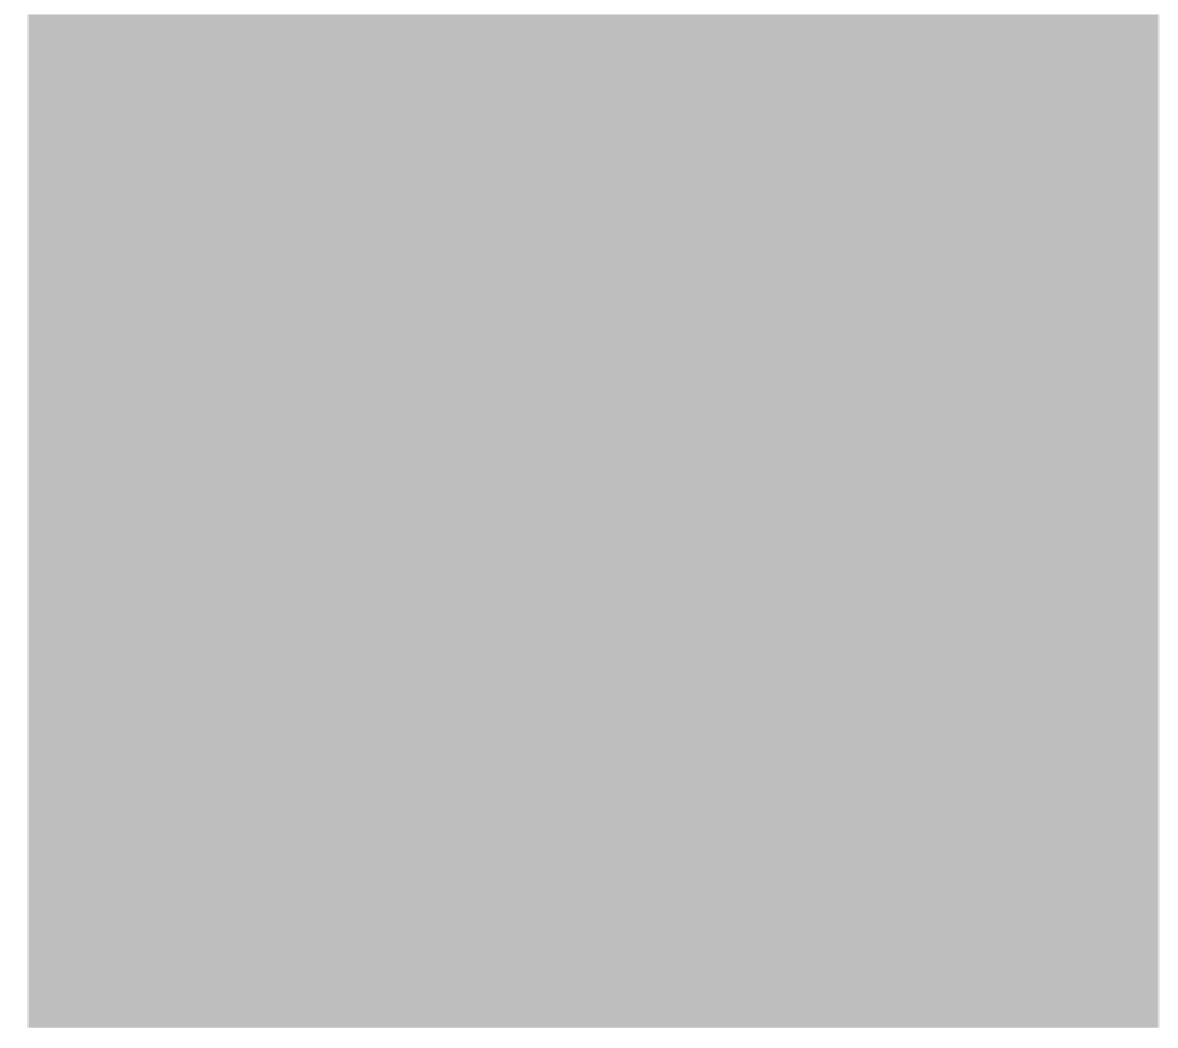
von Mises distribution
𝚱 = 0
0
360

Slide 52
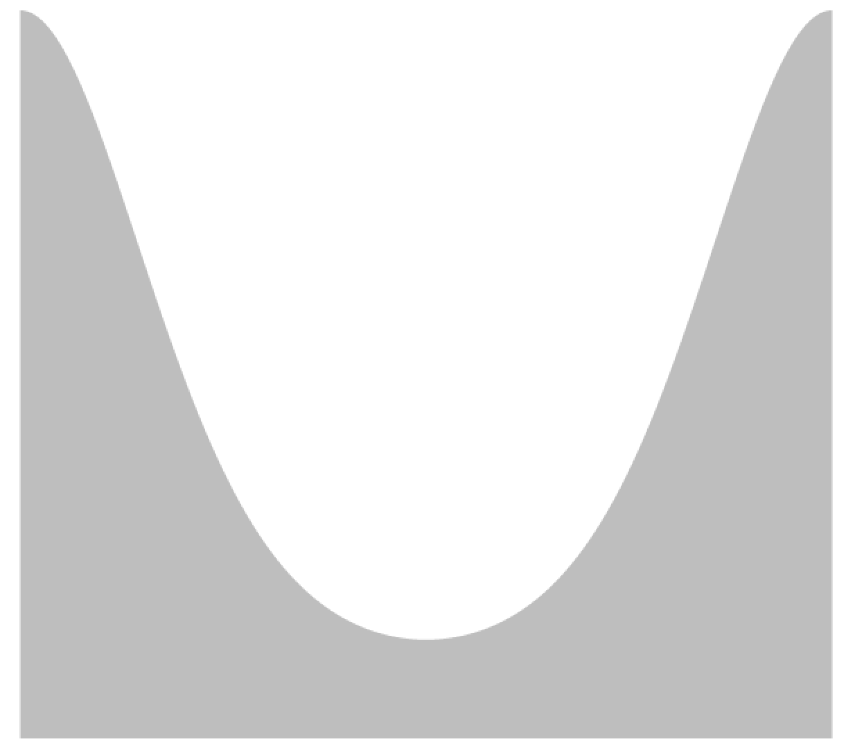
von Mises distribution
𝚱 = 0
𝚱 = 1
0
360
0
360

Slide 53

von Mises distribution
𝚱 = 0
𝚱 = 1
𝚱 = 5
0
360
0
360
0
360

Slide 54

Statistical tests with directional data

Slide 55
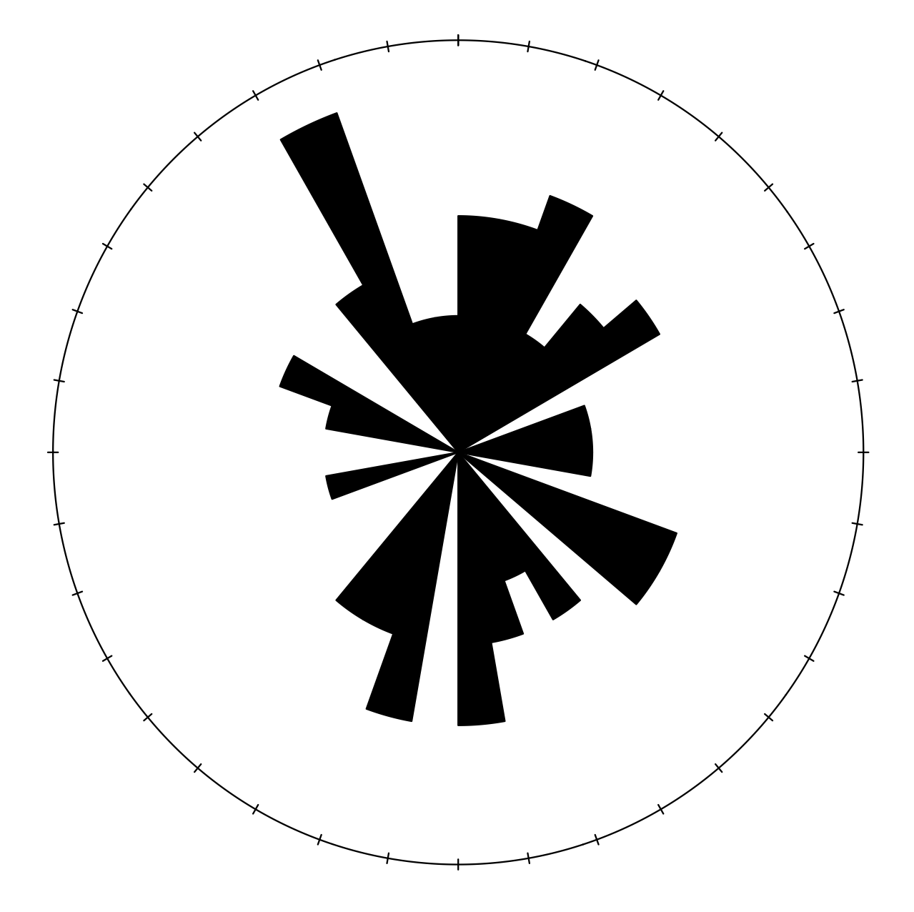
Statistical tests with directional data

Slide 56
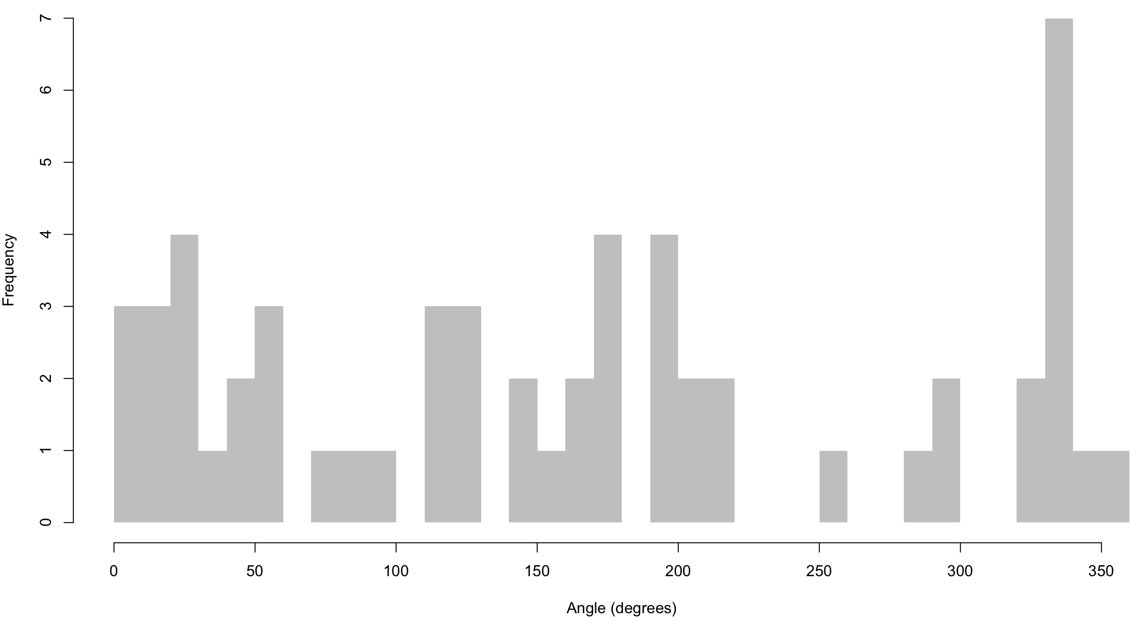
Statistical tests with directional data

Slide 57
Statistical tests with directional data
μ = 166.6

Slide 58
Statistical tests with directional data
μ = 166.6
-σ
+σ

Slide 59
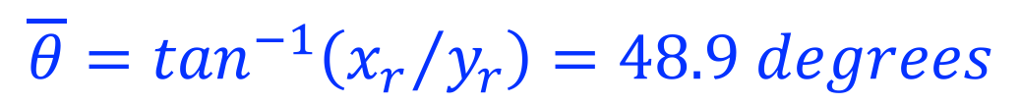
Statistical tests with directional data
Resultant angle
$$\overline{θ}=\tan^{−1}\left({x_{r}}/{y_{r}}\right)=48.9 degrees$$

Slide 60
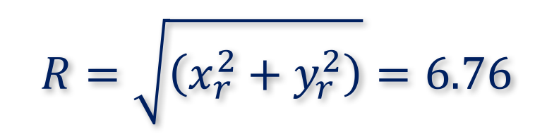
Statistical tests with directional data
Resultant angle
$$\overline{θ}=\tan^{−1}\left({x_{r}}/{y_{r}}\right)=48.9 degrees$$
Resultant length
$$R=\sqrt{\left(x_{r}^{2}+y_{r}^{2}\right)}=6.76$$

Slide 61
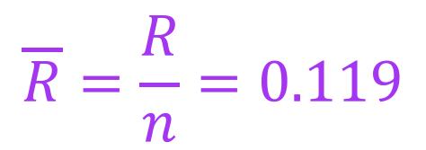
Statistical tests with directional data
Resultant angle
$$\overline{θ}=\tan^{−1}\left({x_{r}}/{y_{r}}\right)=48.9 degrees$$
Resultant length
$$R=\sqrt{\left(x_{r}^{2}+y_{r}^{2}\right)}=6.76$$
Mean resultant length
$$\overline{R}=\frac{R}{n}=0.119$$

Slide 62
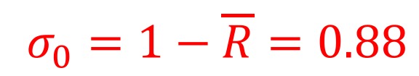
Statistical tests with directional data
Resultant angle
$$\overline{θ}=\tan^{−1}\left({x_{r}}/{y_{r}}\right)=48.9 degrees$$
Resultant length
$$R=\sqrt{\left(x_{r}^{2}+y_{r}^{2}\right)}=6.76$$
Mean resultant length
$$\overline{R}=\frac{R}{n}=0.119$$
Circular variance
$$σ_{0}=1−\overline{R}=0.88$$

Slide 63
Statistical tests with directional data
Univariate mean

Slide 64
Statistical tests with directional data
Univariate mean
Circular mean

Slide 65
Statistical tests with directional data
Rayleigh test
rayleigh.test(SkyeData)
P-value: 0.5501
Test for uniform distribution

Slide 66
Statistical tests with directional data
Rayleigh test
rayleigh.test(SkyeData)
P-value: 0.5501
Test for uniform distribution
Null hypothesis
Data are uniformly distributed

Slide 67
Statistical tests with directional data
Rayleigh test
rayleigh.test(SkyeData)
P-value: 0.5501
Test for uniform distribution
Null hypothesis
Data are uniformly distributed
Alternative hypothesis
Data are non-uniform

Slide 68
Statistical tests with directional data
Cannot reject null at typical alphas (<0.5)
Notes:
Are data really uniform?

Slide 69
Statistical tests with directional data
von Mises distribution
Effectively circular normal
Notes:
Are data really uniform?

Slide 70
Statistical tests with directional data
von Mises distribution
Effectively circular normal
Kappa value
Estimation is effectively a separate test for uniform
Notes:
Are data really uniform?

Slide 71
Statistical tests with directional data
von Mises distribution
Effectively circular normal
Kappa value
Estimation is effectively a separate test for uniform
𝚱 = 0.24175
Low value, indicating well dispersed data
Notes:
Are data really uniform?

Slide 72
Statistical tests with directional data
Chi-squared test
Can apply here to test for uniform; 20 degree bins
Notes:
Are data really uniform?

Slide 73
Statistical tests with directional data
Chi-squared test
Can apply here to test for uniform; 20 degree bins
Chi-squared = 35.52
Degrees of freedom = 18 – 1 = 17
Notes:
Are data really uniform?

Slide 74
Statistical tests with directional data
Chi-squared test
Can apply here to test for uniform; 20 degree bins
Chi-squared = 35.52
Degrees of freedom = 18 – 1 = 17
Alpha = 0.05
Critical value 8.67, therefore reject null; data are non-uniform
Notes:
Are data really uniform?

Slide 75
Statistical tests with directional data
Issue may be polymodality
Notes:
Are data really uniform?

Slide 76
Other tests
One sample t-test equivalent (alpha = 0.05)
Notes:
Are data really uniform?

Slide 77
Other tests
One sample t-test equivalent (alpha = 0.05)
Notes:
Are data really uniform?

Slide 78
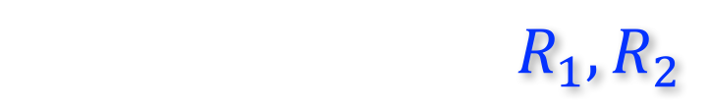
Other tests
Two-sample t-test equivalent
$$R_{1},R_{2}$$
Compares resultants of two samples
Notes:
Are data really uniform?

Slide 79
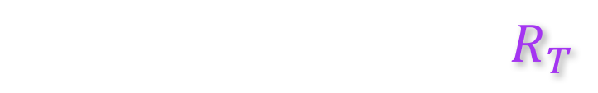
Other tests
Two-sample t-test equivalent
$$R_{1},R_{2}$$
Compares resultants of two samples
R₁ and R₂ are resultants of each sample
$$R_{T}$$
R_{T} is resultant from combined data
Notes:
Are data really uniform?

Slide 80


Other tests
Two-sample t-test equivalent
$$R_{1},R_{2}$$
Compares resultants of two samples
R₁ and R₂ are resultants of each sample
$$R_{T}$$
R_{T} is resultant from combined data
Close means indicate approximately equal values
$$R_{1}+R_{2}≈R_{T}$$
Distant means indicate smaller combined resultant
$$R_{1}+R_{2}≫R_{T}$$
Notes:
Are data really uniform?

Slide 81
Other tests
R₁
R₂
R_{T}
Notes:
Are data really uniform?

Slide 82
Other tests
R₁
R₂
R_{T}
Modified F-statistic allows null hypothesis statistical testing
Notes:
Are data really uniform?

Slide 83
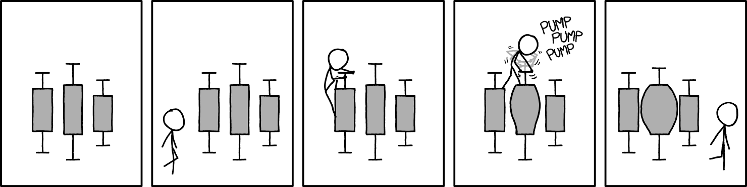
Boom goes the dynamite
Source: xkcd

